Slide 1
Semantic Healthcare Paper Diagrams

Slide 2

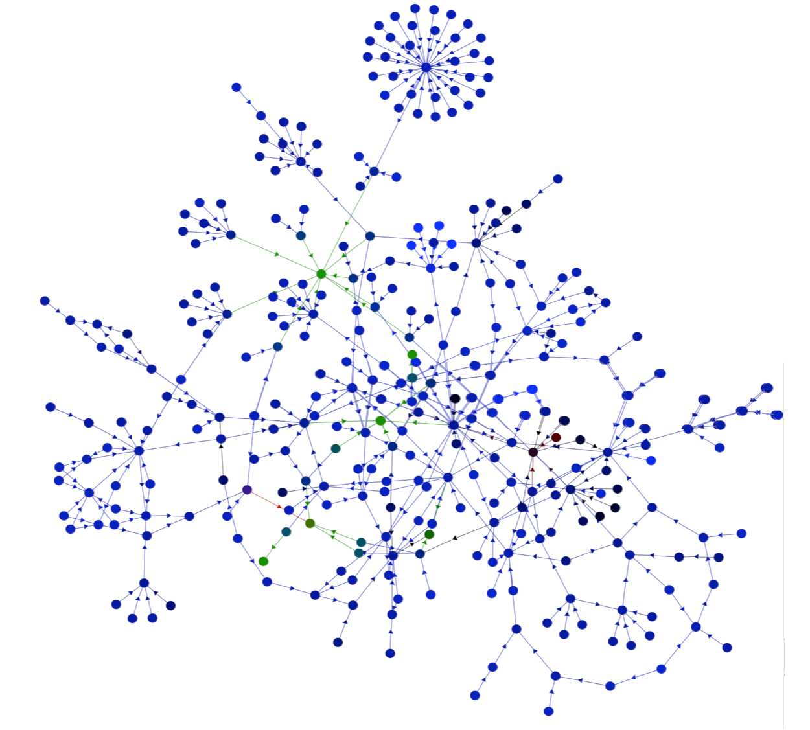
Clinical
Viewpoint
Guideline
Viewpoint
Concepts
EHR Viewpoint
Binding

Slide 3

Clinical
Viewpoint
Guideline
Viewpoint
Concepts
HIT Viewpoint
Binding

Slide 4

Clinical
Viewpoint
Guideline
Viewpoint
EHR Viewpoint

Slide 5
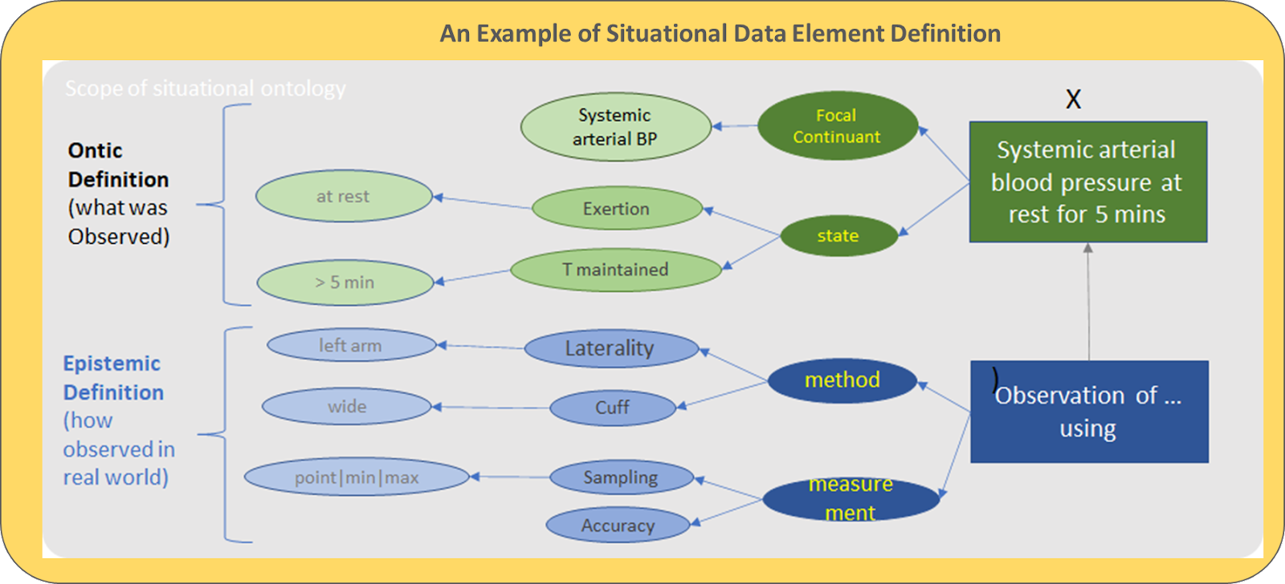
Clinician
Name
Patient
Name
Age
Blood Pressure
Blood Pressure

Slide 6
Clinician
Name
Name
Patient
Age
Blood Pressure
SA5 Blood Pressure

Slide 7
